Slide 1

RentalCamera : Your Online Camera & Lens Rental Platform

Slide 2
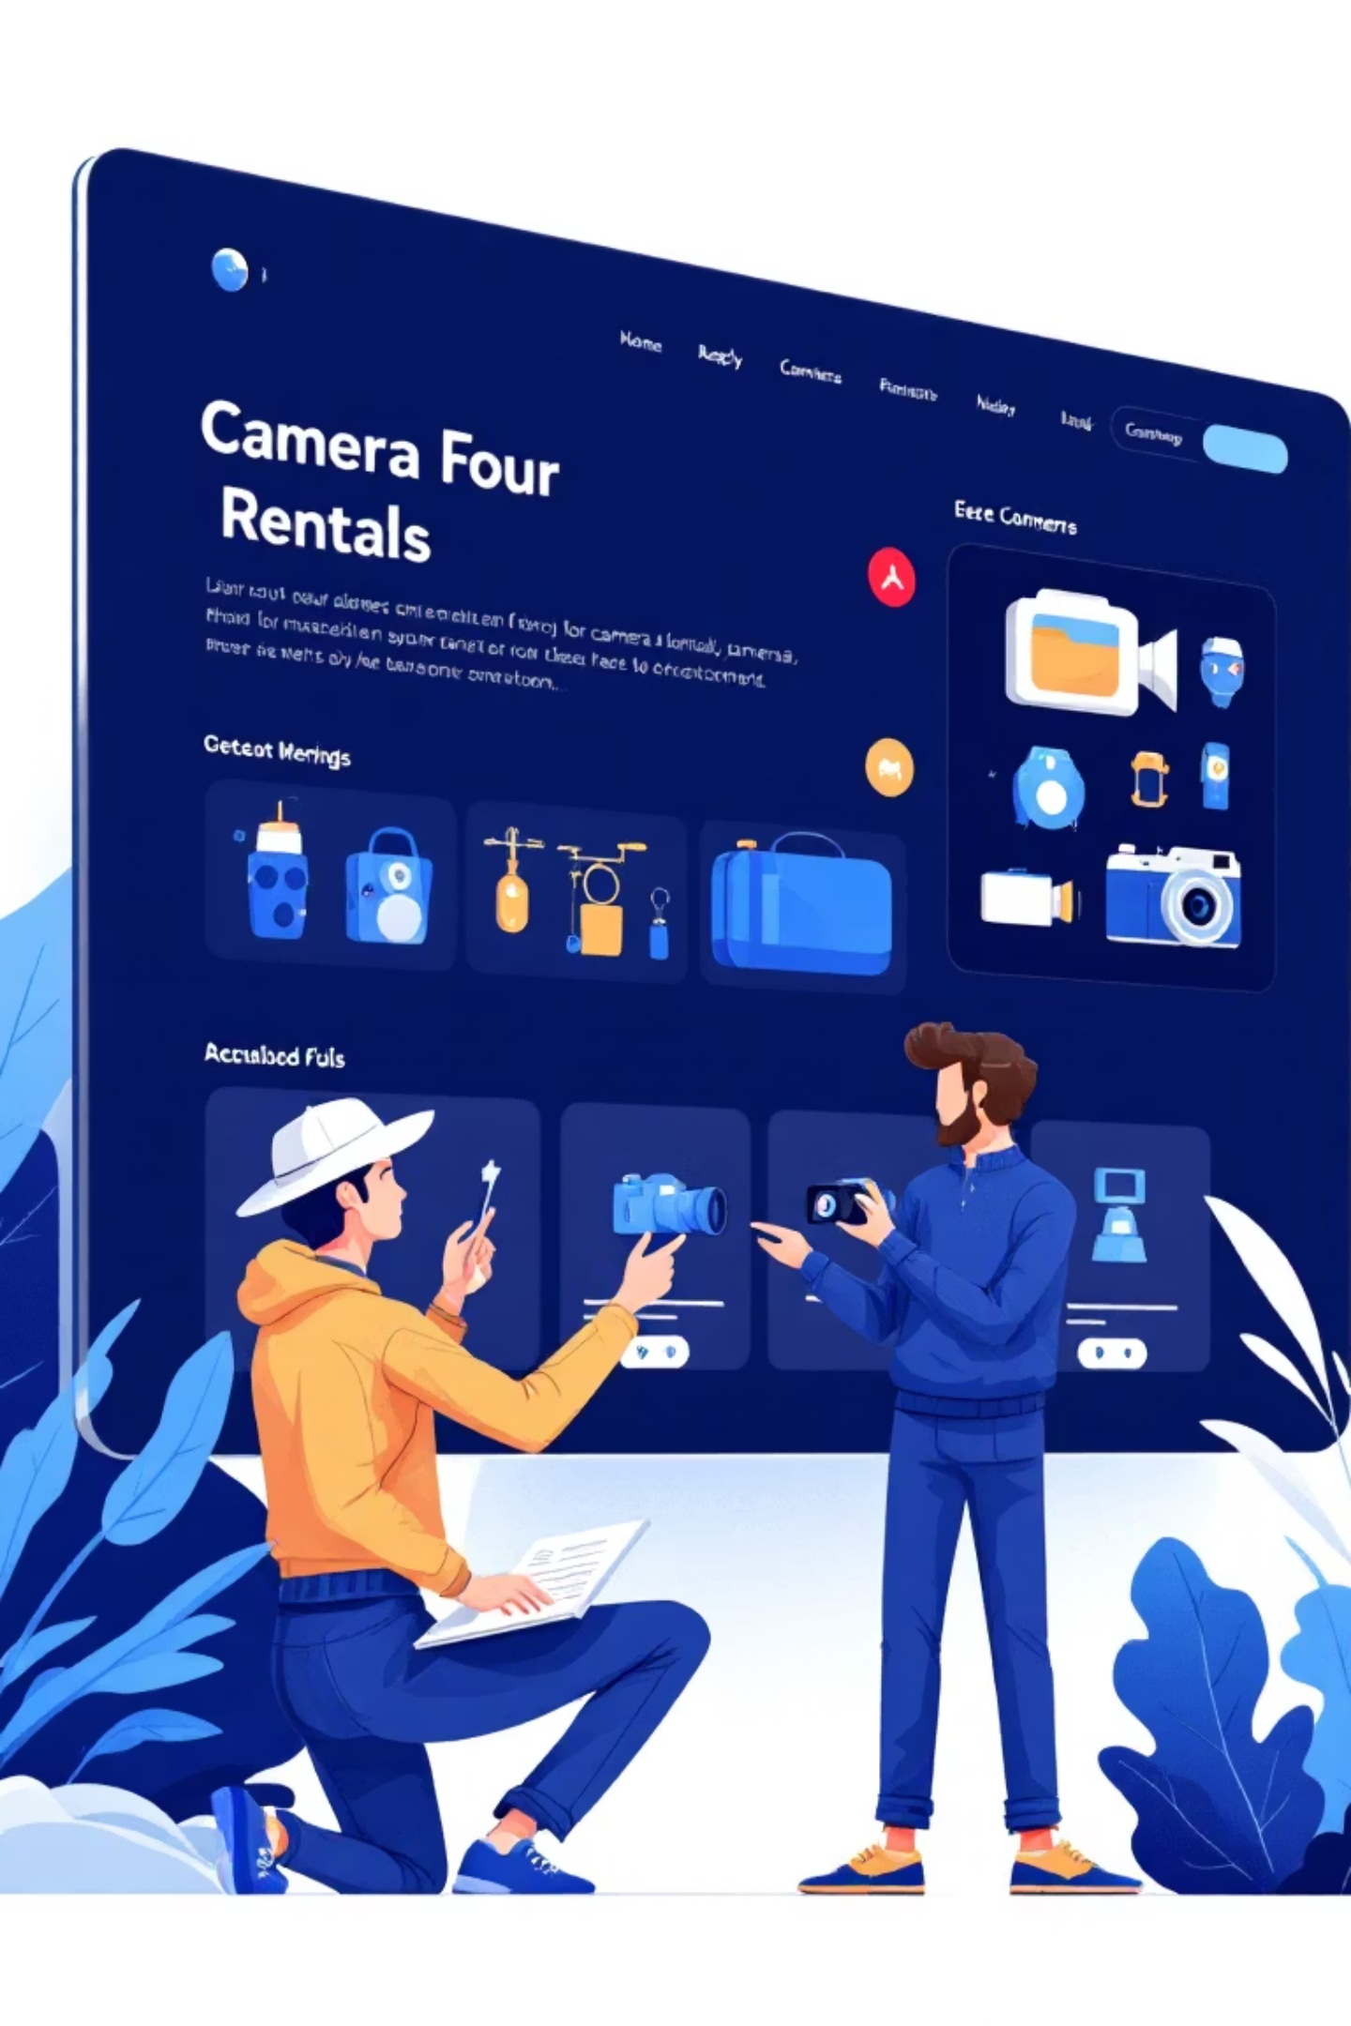
The Concept: Unleash Your Creativity
Hassle-Free Access
Rent professional cameras and lenses online without the ownership burden.
Top-Tier Gear
Access the latest and greatest equipment, enabling high-quality results for every project.
Flexible Rentals
Ideal for photographers and videographers needing short-term, adaptable equipment solutions.
Intuitive Experience
A modern, user-friendly platform designed for effortless browsing and booking.

Slide 3


Who Benefits from Rental Camera ?
Freelance Creatives
Achieve professional results on a budget, expanding their service offerings.
Content Creators
Always have access to cutting-edge gear for their next viral video or photoshoot.
Event Professionals
Acquire specialised equipment for unique event demands, without long-term commitment.
Passionate Hobbyists
Experiment with diverse camera bodies and lenses before making a significant investment.

Slide 4

RentalCamera : Core Features
Extensive Catalogue: DSLRs, mirrorless, cinema cameras, lenses, and essential accessories.
Real-time Availability: Instant booking confirmations, ensuring you get the gear you need, when you need it.
Flexible Rental Periods: Choose from hourly, daily, or weekly options to fit any project timeline.
Secure User Profiles: Track rental history and preferences for a personalised experience.
Integrated Chat Support: Get expert advice and assistance with gear selection.

Slide 5
Benefits for Every User
Cost-Effective
Try Before You Buy
Zero Maintenance
Access premium gear without the burden of ownership or hefty upfront costs.
Experiment with various models to make informed purchasing decisions.
Forget about upkeep and storage; we handle all the logistics.
Convenient Delivery
Peace of Mind
Flexible delivery and return options tailored to your busy schedule.
Transparent security deposit system ensures a worry-free rental experience.

Slide 6

Transparent Pricing Model
We believe in clear, straightforward pricing with no hidden surprises. Our model is designed to offer maximum value and flexibility.
Competitive Rates: Attractive daily and weekly rental rates based on equipment category.
Refundable Deposit: A transparent security deposit, fully returned upon safe return.
Optional Insurance: Add-on protection for accidental damage, giving you extra peace of mind.
Loyalty Rewards: Discounts for repeat customers and bundle rentals.

Slide 7
Seamless Rental Journey
01
02
1. Browse & Select
2. Customise Rental
Explore our extensive catalogue online and choose your desired gear.
Specify duration and preferred delivery or pick-up method.
03
04
3. Secure Booking
4. Receive Gear
Confirm your reservation with payment and a refundable security deposit.
Your equipment is delivered to your chosen location or ready for collection.
05
06
5. Create & Return
6. Deposit Refund
Complete your project, then return the gear by the scheduled time.
Deposit promptly refunded after inspection and confirmation of safe return.

Slide 8

Security Deposit & Equipment Protection
Our robust security deposit system is designed to protect both our valuable equipment and your peace of mind.
Variable Deposit: Amount adjusted based on the value of the rented equipment.
Pre-Rental Checklist: Detailed condition checks and photographic records before dispatch.
Full Refund Guarantee: Deposit fully returned upon the gear's undamaged and timely return.
Damage & Late Policies: Clear guidelines to ensure fair treatment for all.
Accidental Damage Cover: Opt for insurance to cover unforeseen incidents.

Slide 9
Effortless Delivery & Return
Fast & Tracked Delivery
Flexible Return Options
Contactless Handover
Reliable courier service direct to your location or a convenient local pick-up point.
Schedule a courier pick-up or drop off at designated locations.
Streamlined digital checklists and signatures for a safe and efficient exchange.
Real-time Updates
Dedicated Support
Stay informed with instant notifications on your order's status.
Our team is always ready to assist with any delivery or return queries.

Slide 10




Why RentalCamera is Your Creative Partner
1
Community Trust
2
Sustainable Choice
3
Cost-Effective Empowerment
4
Seamless Experience
SnapRent empowers creatives with affordable access to professional gear, saving money, time, and hassle compared to ownership. We support sustainable consumption by maximising gear utilisation and offer a modern UI with clean icons for a seamless experience. Join a growing community of photographers and videographers who trust SnapRent to elevate their craft.

